Slide 1

<MITECH INDUSTRIES>
Apoorva Jain
29.10.2017
Case #3
Prepared for
EMIS 7360

Slide 2
IT is the key for the growth and future expansion for MiTech..!!!
Background
Overview of Business
MiTech is a company of $40 MM.
Headquarter of the company is in Rosemount Illinois.
It have various sales office across USA, Austin, El Paso, New York etc.
It was founded back by CEO Tom Mackwiz in 1988.
Co-operation with Nvidia .
Tom stated that the increase in cost squeezes the margins.
They make circuit boards for the video card but labelled by AMD, Nvidia.
They bought company who invented their own printed circuit board design software.
CEO, COO and CFO thinks that the key factor of growth lies in technology.
The company consist of 95 employees.
They use a third party freight for delivering purposes.

Slide 3
Background
Overview of IT
The IT director is Stan Brown since 2005.
Stan reports to the COO, Hank Gordon.
He hired a network engineer and a security architect.
Capital investments are the main decision made in the past years with a depreciation of 5-7 years.
There are nearly about 22 people working in the IT department.
They just did a naïve work on budgeting and told Zeke to approve the last years budget with an increment of 2 percent that will work.

Slide 4
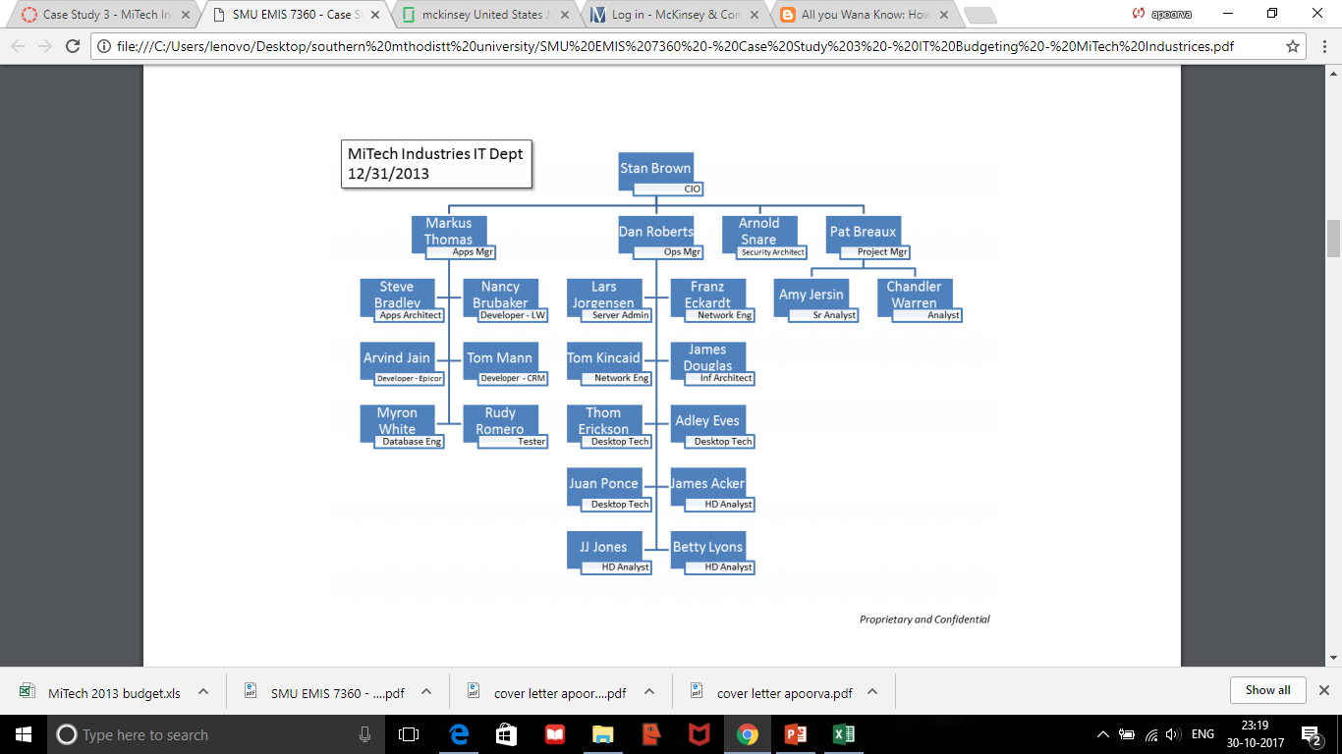
Prioritize the projects !! Lots of upgrade needed!!! .
Findings
The average profit margin is $4MM.
  Its stated that the company has a business of $40MM.
The Applications such as litewave need to be upgraded
  Its been stated that litewave need to be upgraded as it doesn’t support the database by INFORMIX.
Ticket tracking method should be changed.
  This is stated that they use MS excel for tracking the generated tickets.
At present there is one tester.
  As shown below in the figure.

Slide 5
The CIO of the company just gives the preliminary idea for the budget.
  As stated when he presented the work to Zeke for approval.
Annual budget should be increased for the IT department .
  This is stated that 2014 is an important and challenging year to the company.
  Lot of projects pending to be completed in IT so that they can achieve the goal so budget needs to be increased.
The systems should be upgraded.
  Stated that they need to upgrade there back end data and even MS exchange 2008.

Slide 6
We need to grow with Intellectual ideas !! No preliminary ones.!!!!
Recommendation
They should update the LITEWAVE .
  That will ease and be convenient to access the database.
  Efficient results from the software which doesn’t support Informix database which supports SQL.
The Ticketing method should be changed from MS excel.
  They should opt for online ticketing application which will ease there work and will be efficient, that will save there time and in person so that they can work on other innovation's in IT to perform well.
They should reduce the salary of CIO.
  They should appoint a more graceful and intellectual person who innovates not just give naïve idea about the investment and technology.
  Reduce the salary till $9k/month and invest on the upgradation of software's and other necessity.
Markus is one of the oldest employee.
  Just reduce a salary for a while as he will understand its for the growth of company and ensure them to give bonus and upgrade there pay in 10-12 months back.

Slide 7
We simply need more tester
  Because we need to initialize two important projects which need tester and we just have only one tester for enhancing the IT department.
They should also increase salary of the project manager, data engineer and tester.
-They are already working a lot to improve so little benefits for them so that they will work more for the future growth of the company and in the most challenging year for the MiTech Industries.
Do not order 15 desktops for $820/ per desktop.
-They should just order 7 desktops because the budget should be sent wisely.
- Already we are upgrading the softwares so they will even work and rest of 7 will be already upgraded with the latest technology so no need of buying 15 desktops.
Upgrade MS exchange from 2008 to the latest one
They should start a tie up or open there own freight.
- That will help them in future when they will be expanding and it will be constant and work according to them.

Slide 8
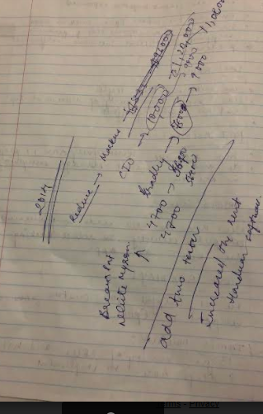
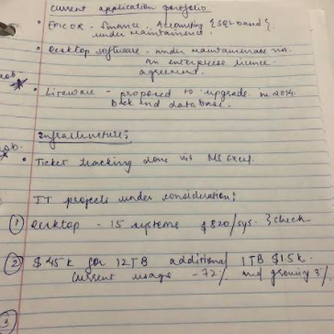
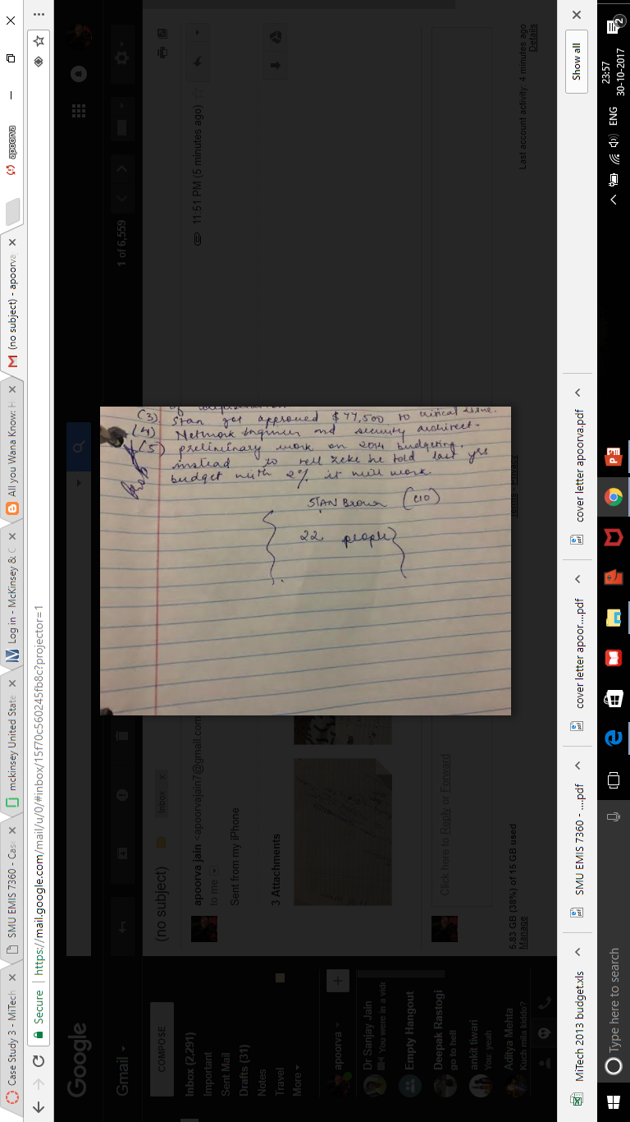
Working notes
Working Notes
1 – 10% is generally profit that is equal to $ 4MM.

